Slide 1
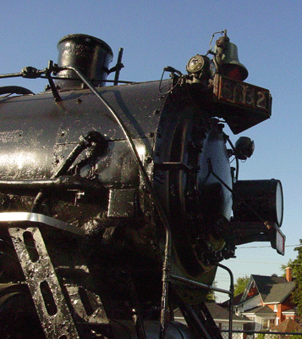
The Pere Marquette

Slide 2
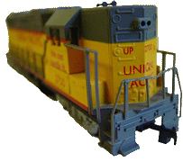
Engine, Engine No 9

Slide 3
Going Down Chicago Line

Slide 4
If the Train Should Jump the Track

Slide 5
Do You Want Your Money Back?

Slide 6
Stopping By Woods on a Snowy Evening
Robert Frost
1923

Slide 7
Whose woods these are I think I know. His house is in the village though;

Slide 8
My little horse must think it queer To stop without a farmhouse near

Slide 9
Between the woods and frozen lake The darkest evening of the year.

Slide 10
He gives his harness bells a shake To ask if there is some mistake.

Slide 11
The only other sound's the sweep Of easy wind and downy flake.

Slide 12
The woods are lovely, dark and deep. But I have promises to keep,

Slide 13
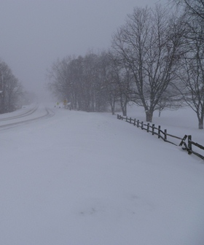
And miles to go before I sleep, And miles to go before I sleep.

